Slide 1

Windows 9 corp.
Floor counting and window recognition challenge
-Nicolas Oulianov
-Mateusz Blommaert
-Krzysztof Kamiński
-Juan Pablo Usuga Cadavid
Floors & Window detection - ATHENS

Slide 2
Content
Business problem
Perspective distortion fix
K-means approach
Edge projection
Conclusion
Floors & Window detection - ATHENS

Slide 3
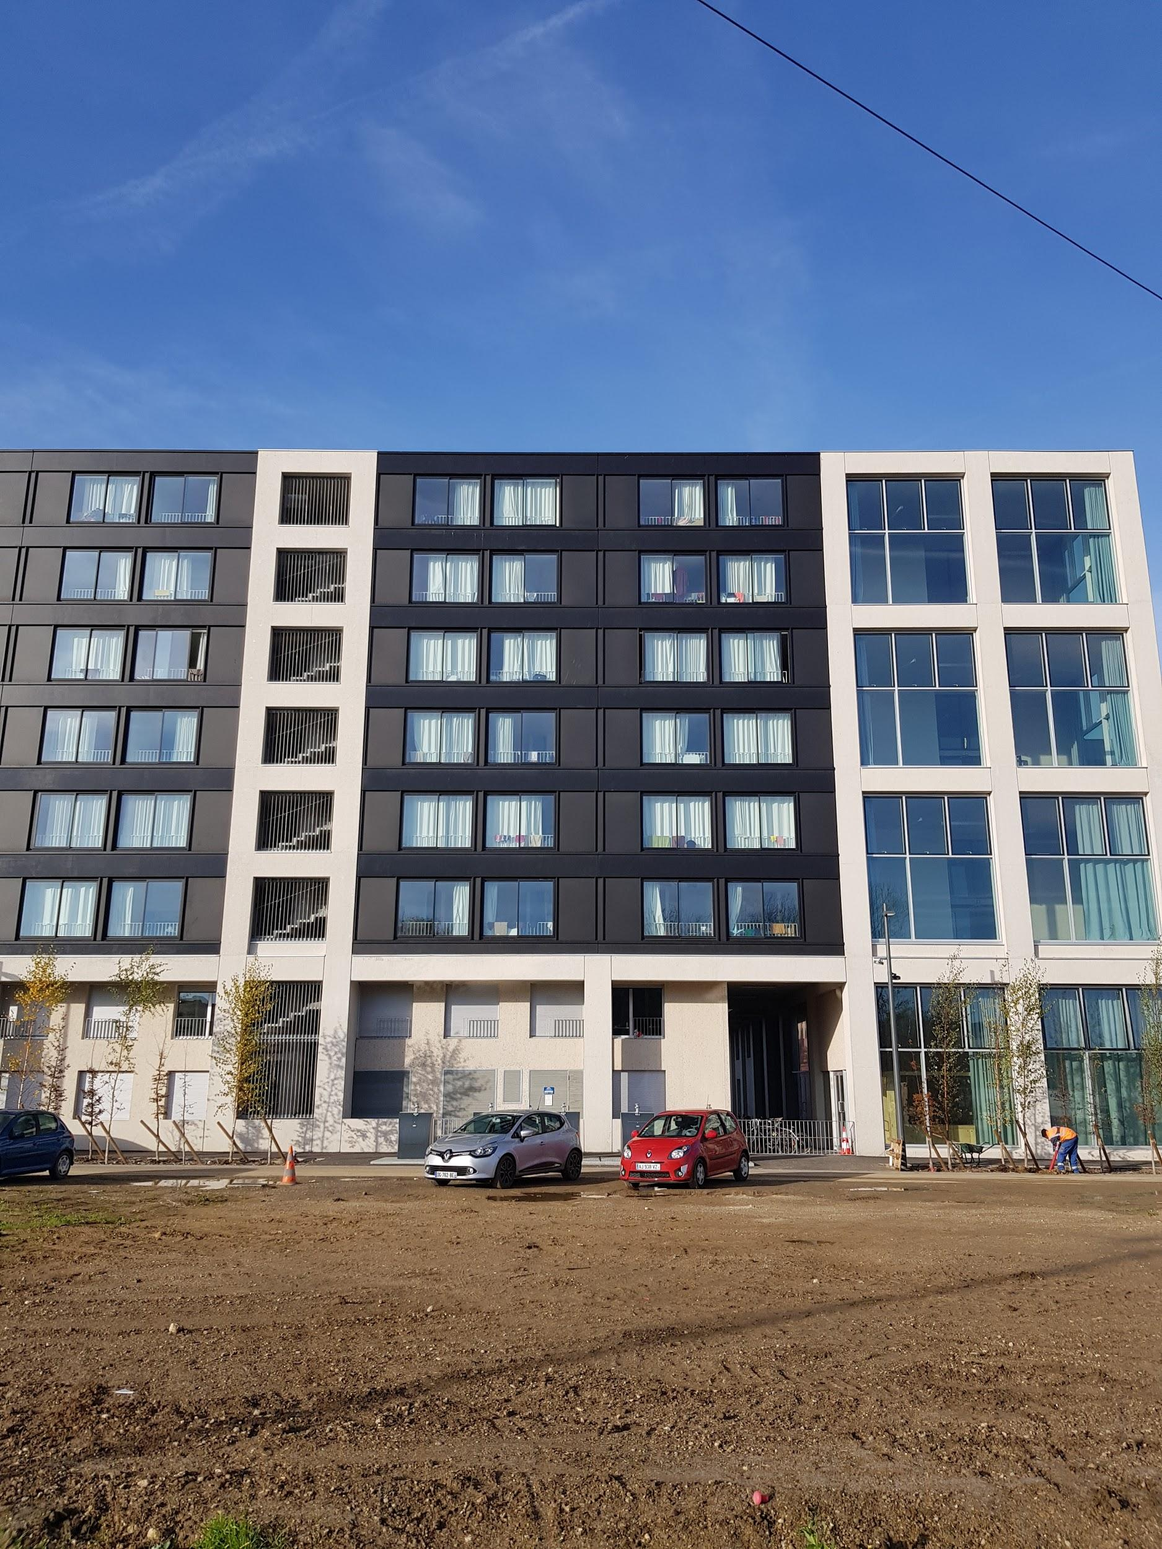
1
Business problem

Slide 4

Business problem
How many floors has this building ?
How many windows ?

Slide 5
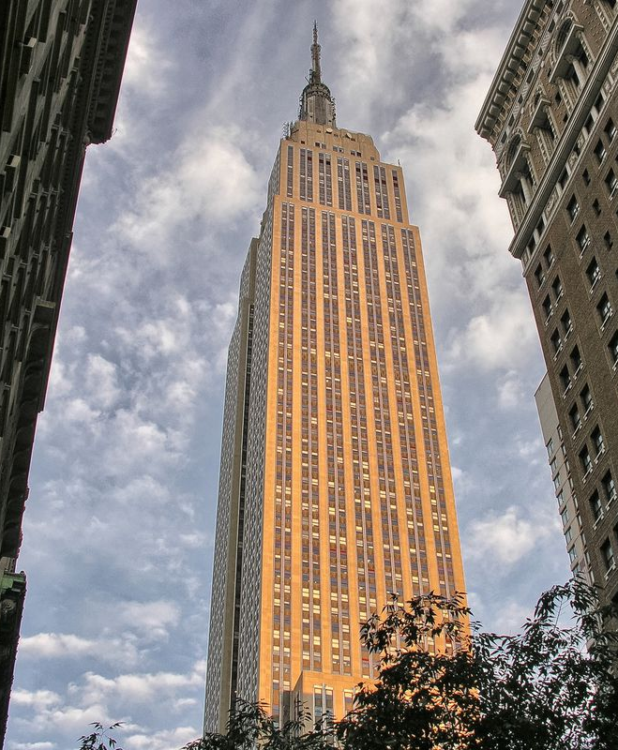
Business problem
And now ?

Slide 6
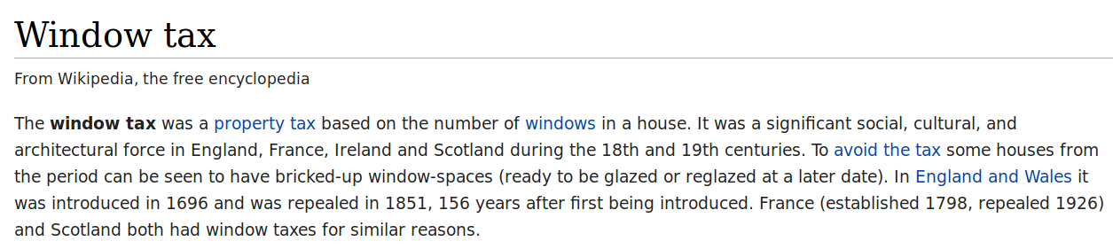
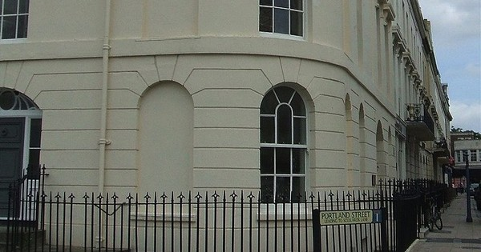
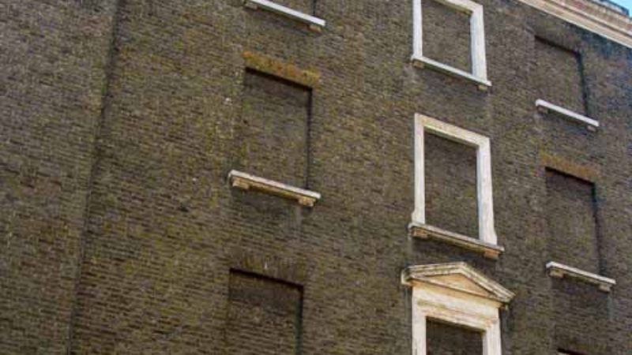
Business problem

Slide 7
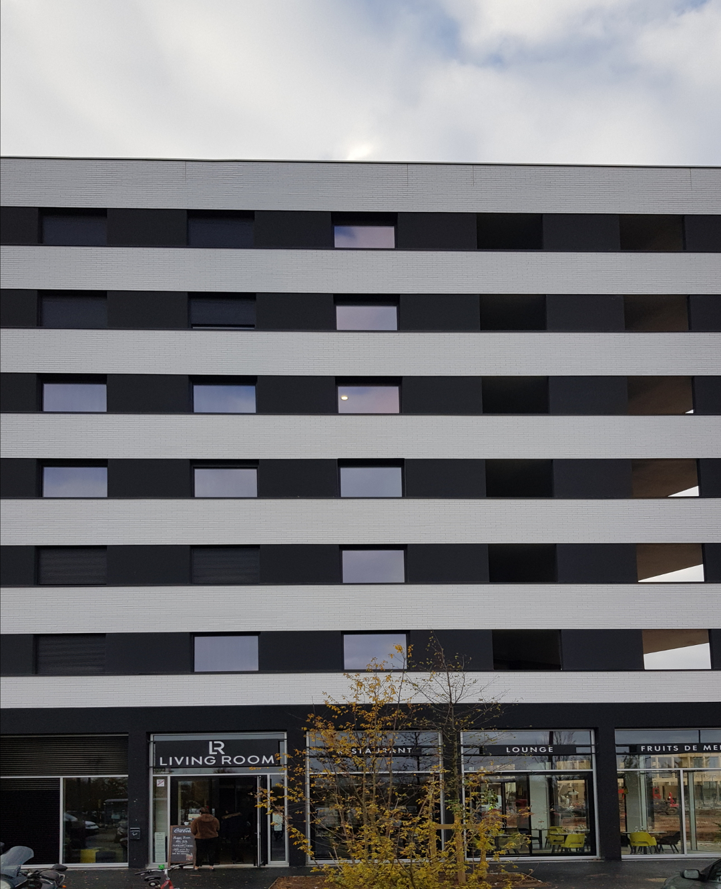
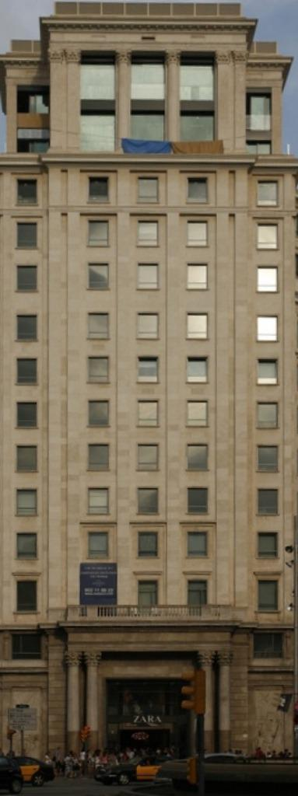
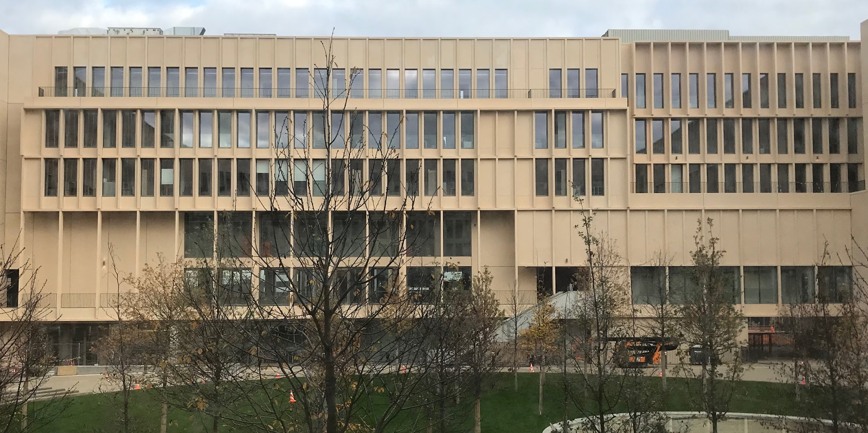
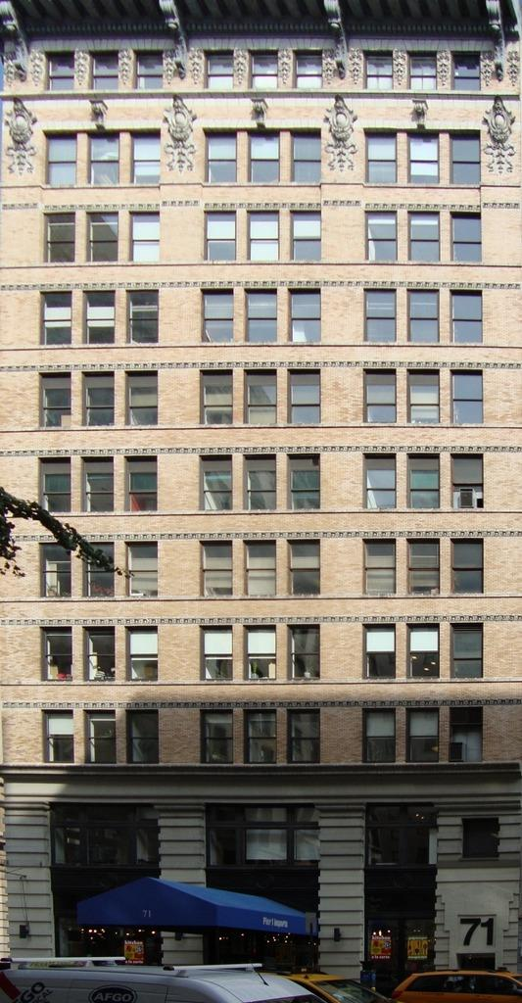
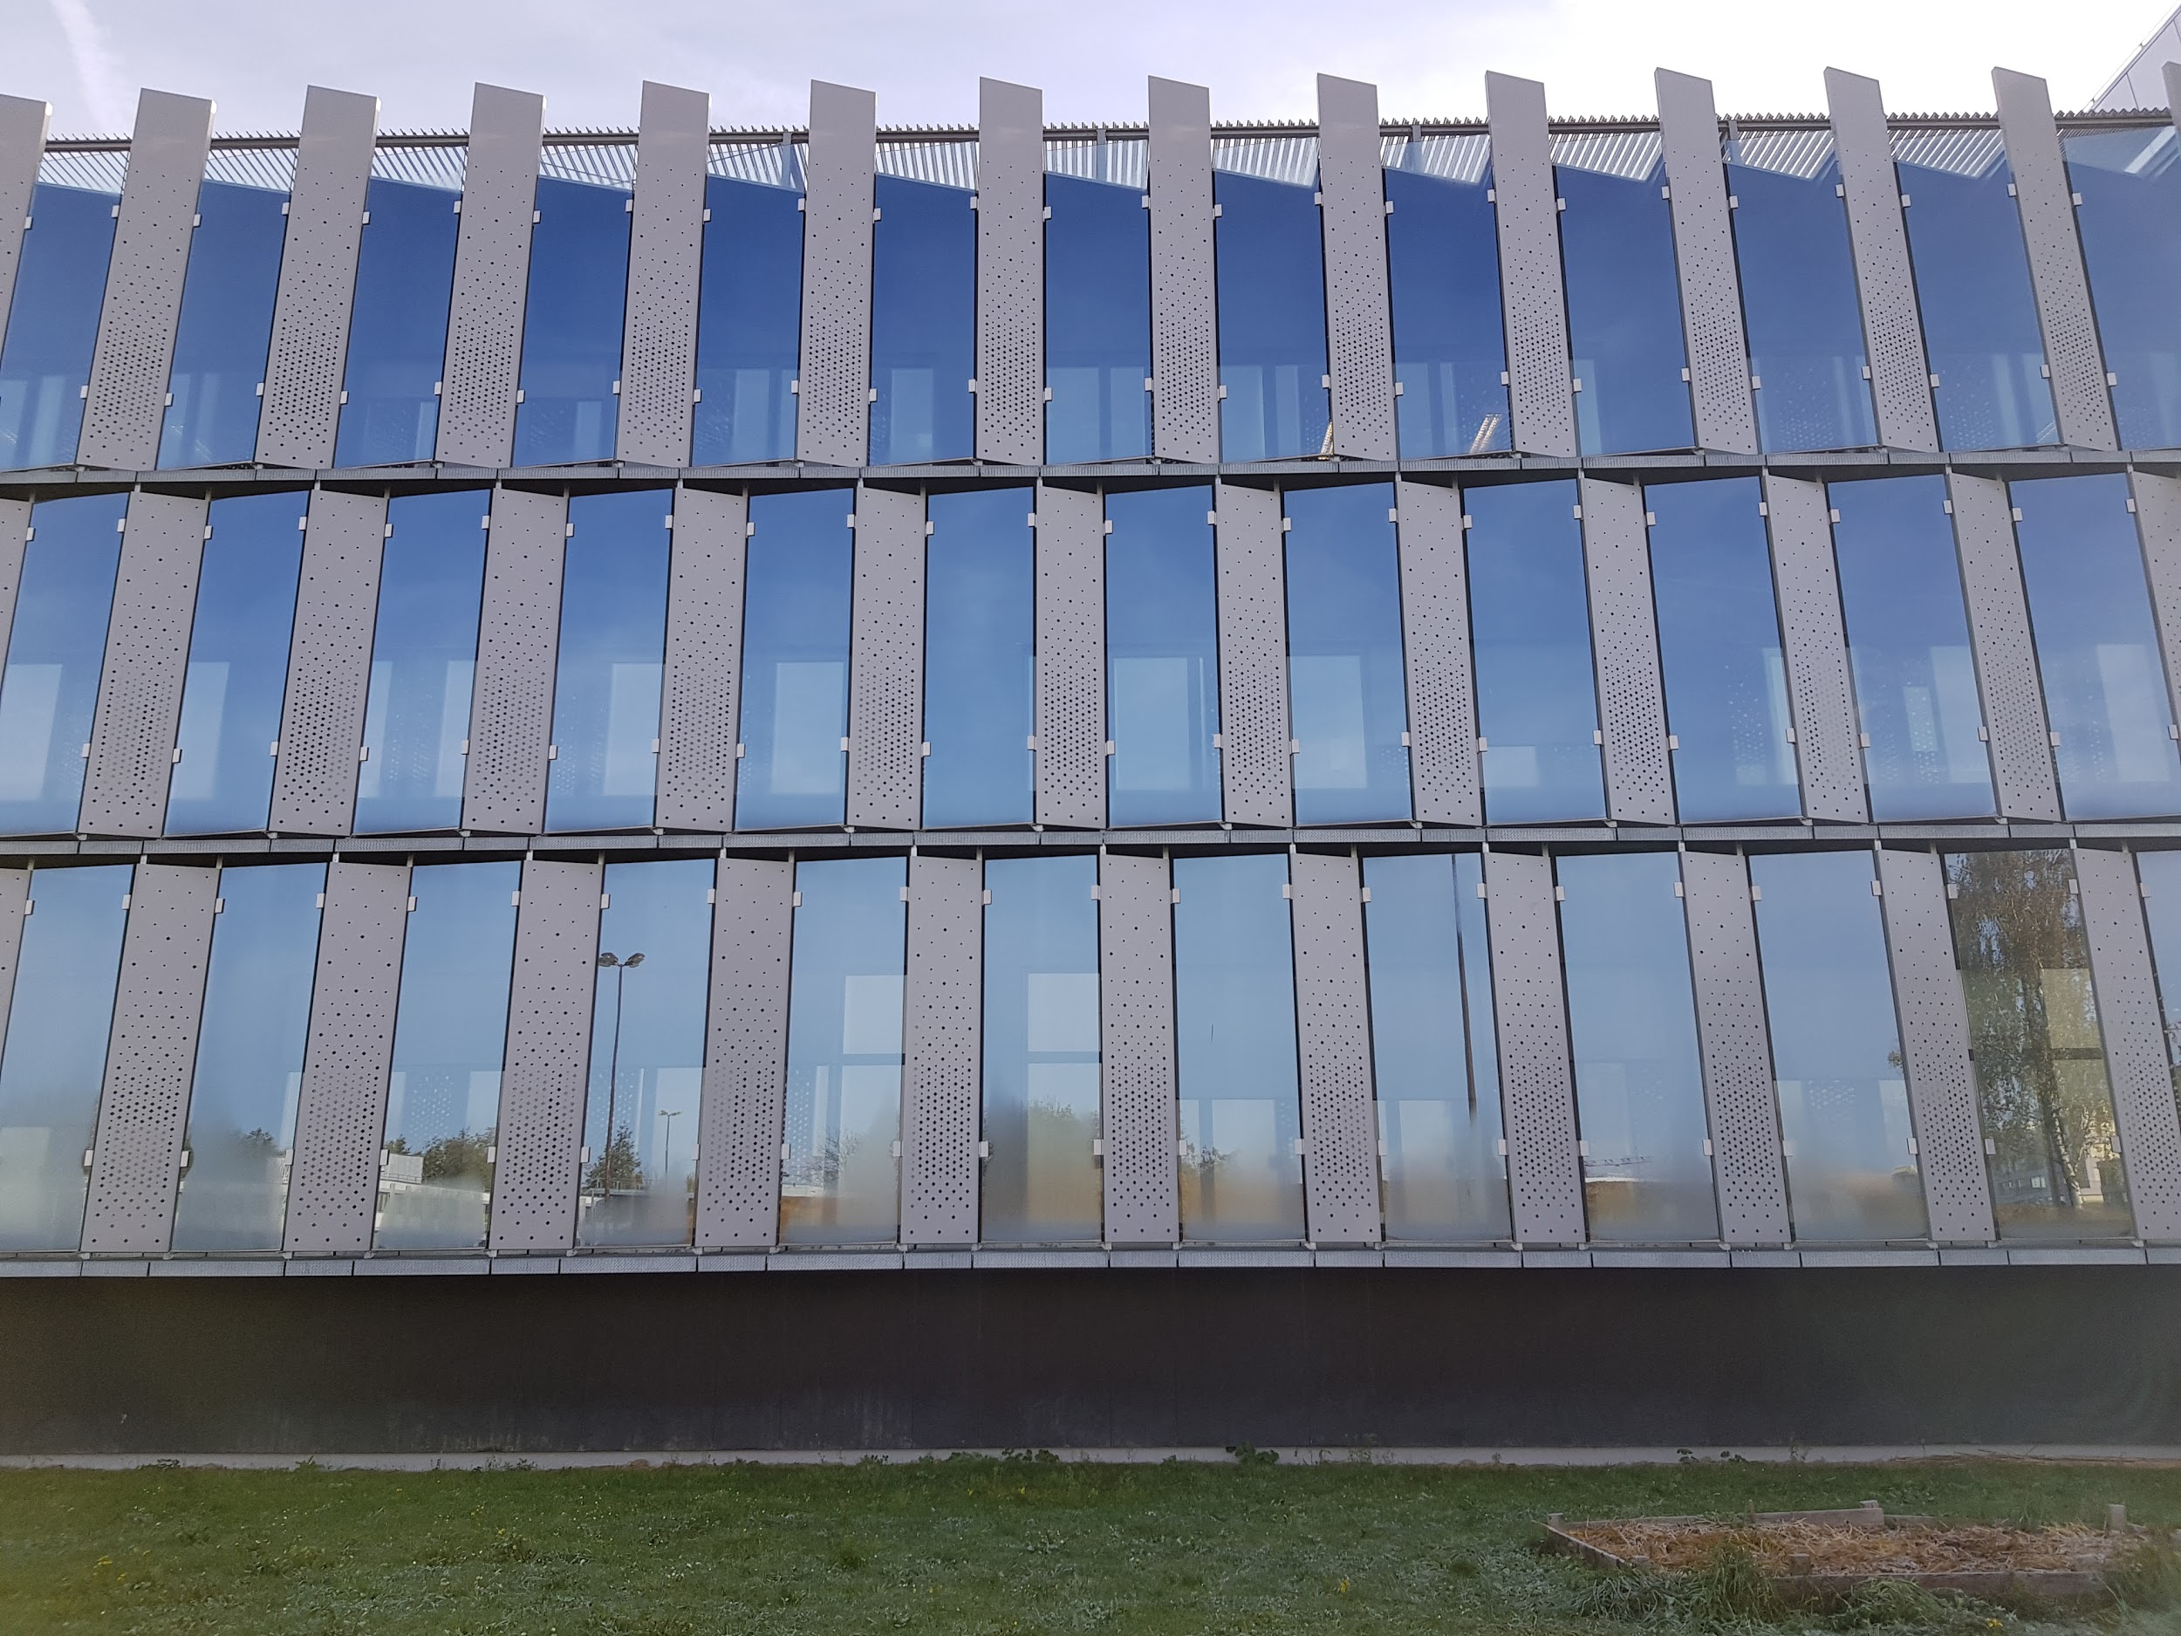
Goal : Count the number of floors on façades of modern buildings

Slide 8
2
Perspective distortion fix

Slide 9
Problem definition
Photos taken from the ground
Rectangles malformed by the perspective

Slide 10
Algorithm
Ask for input
Calculate target
Calculate transformation matrix
Apply transformation
User selects 4 points on image, that are a rectangle in real world.
Calculate middle points for each segment connecting previously selected points.
Generate a rectangle that intersects all the points.
Generate projective transformation for the image.
Return an image with fixed perspective.
Save result to file.

Slide 11
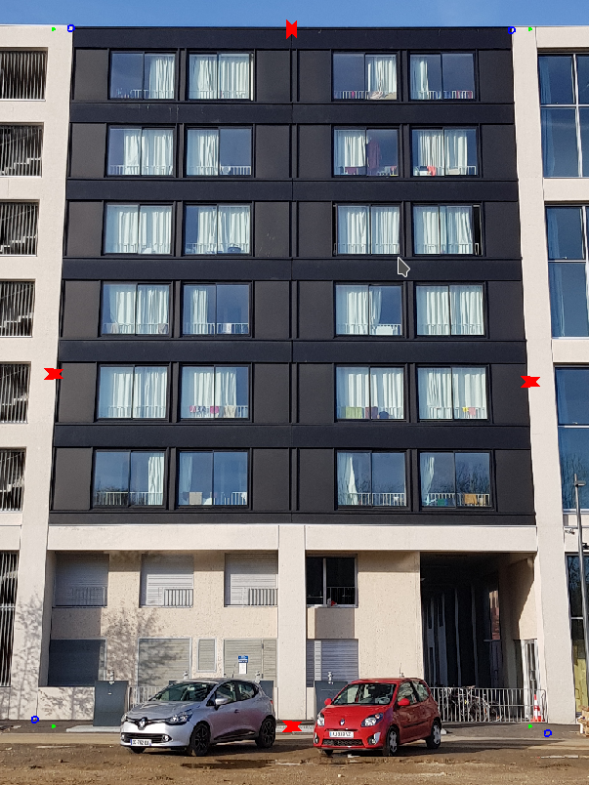
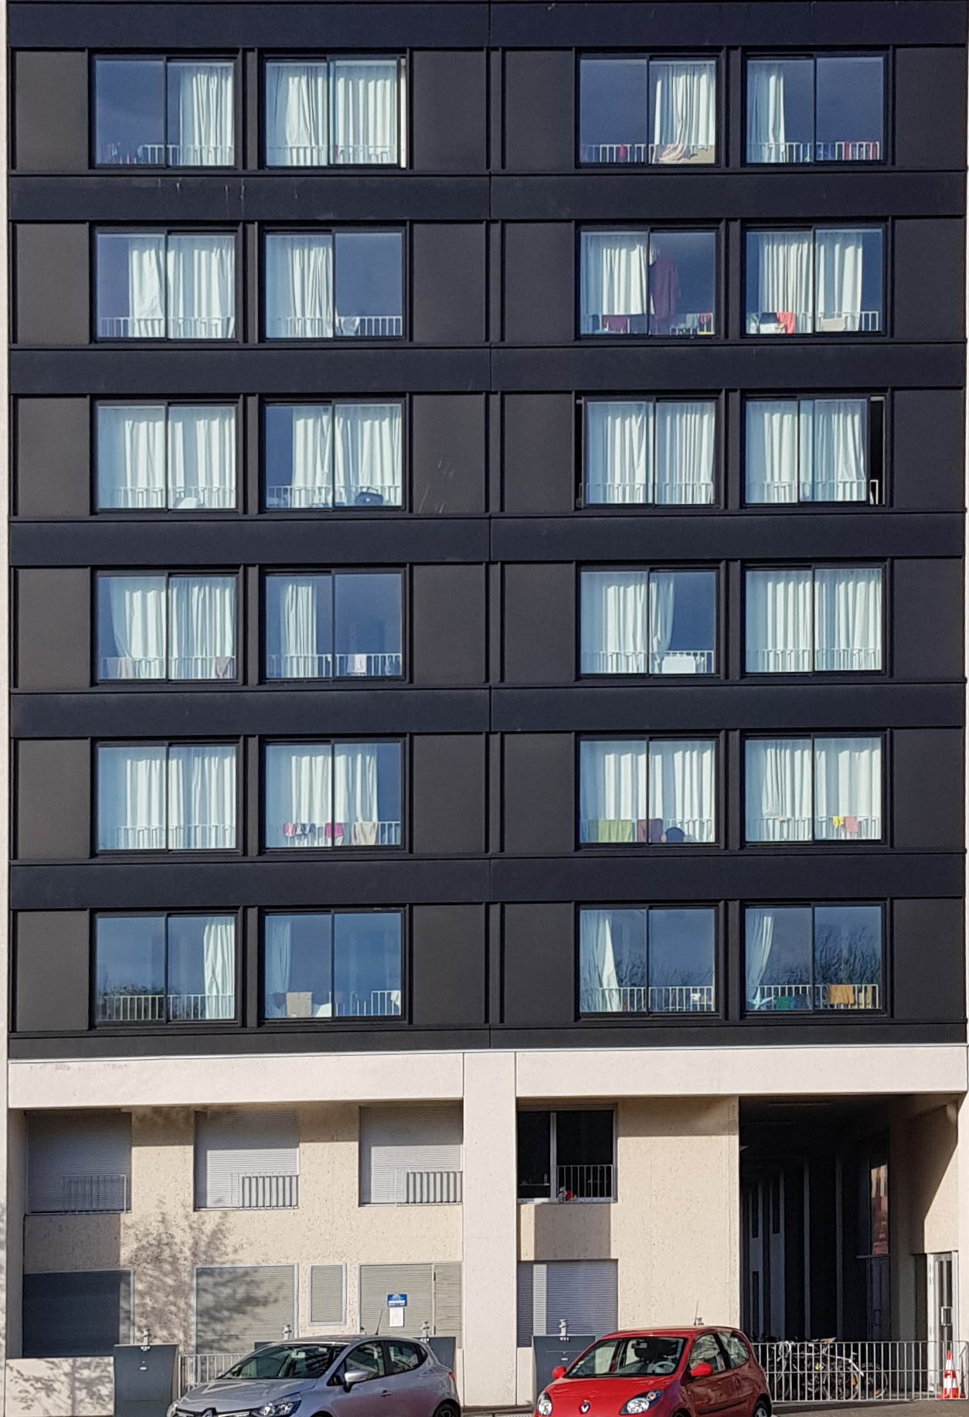
User Interface

Slide 12
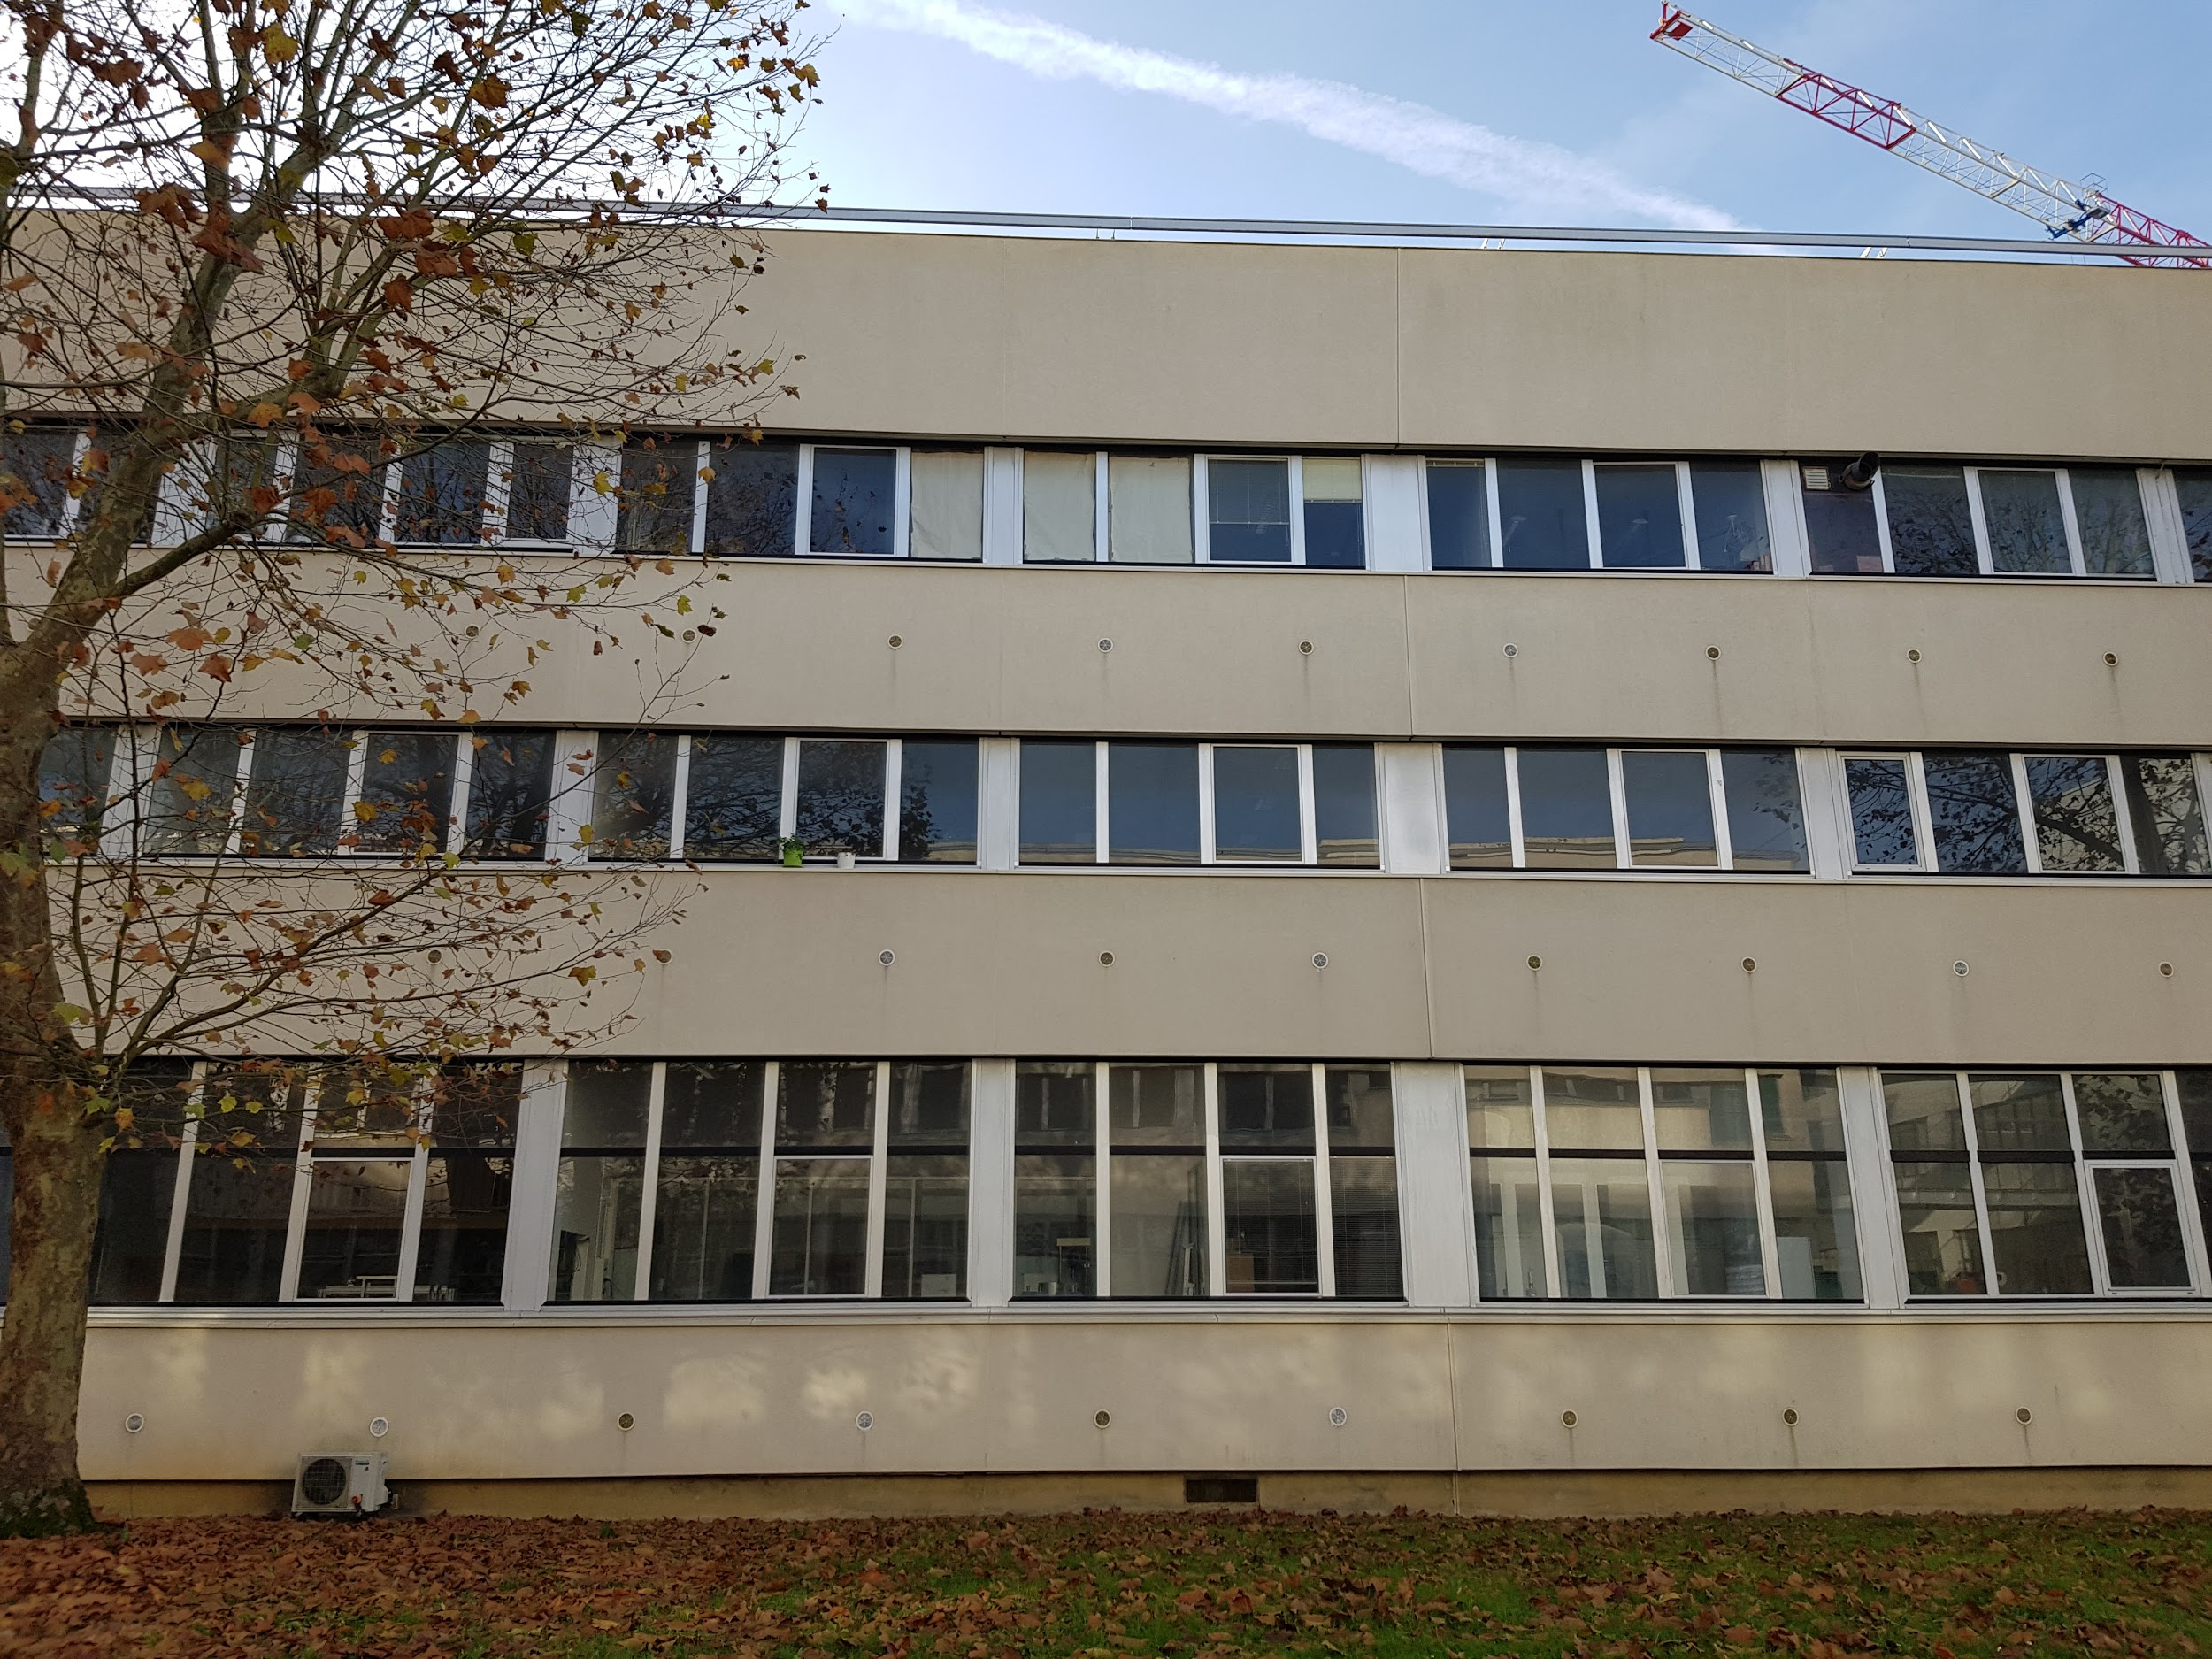
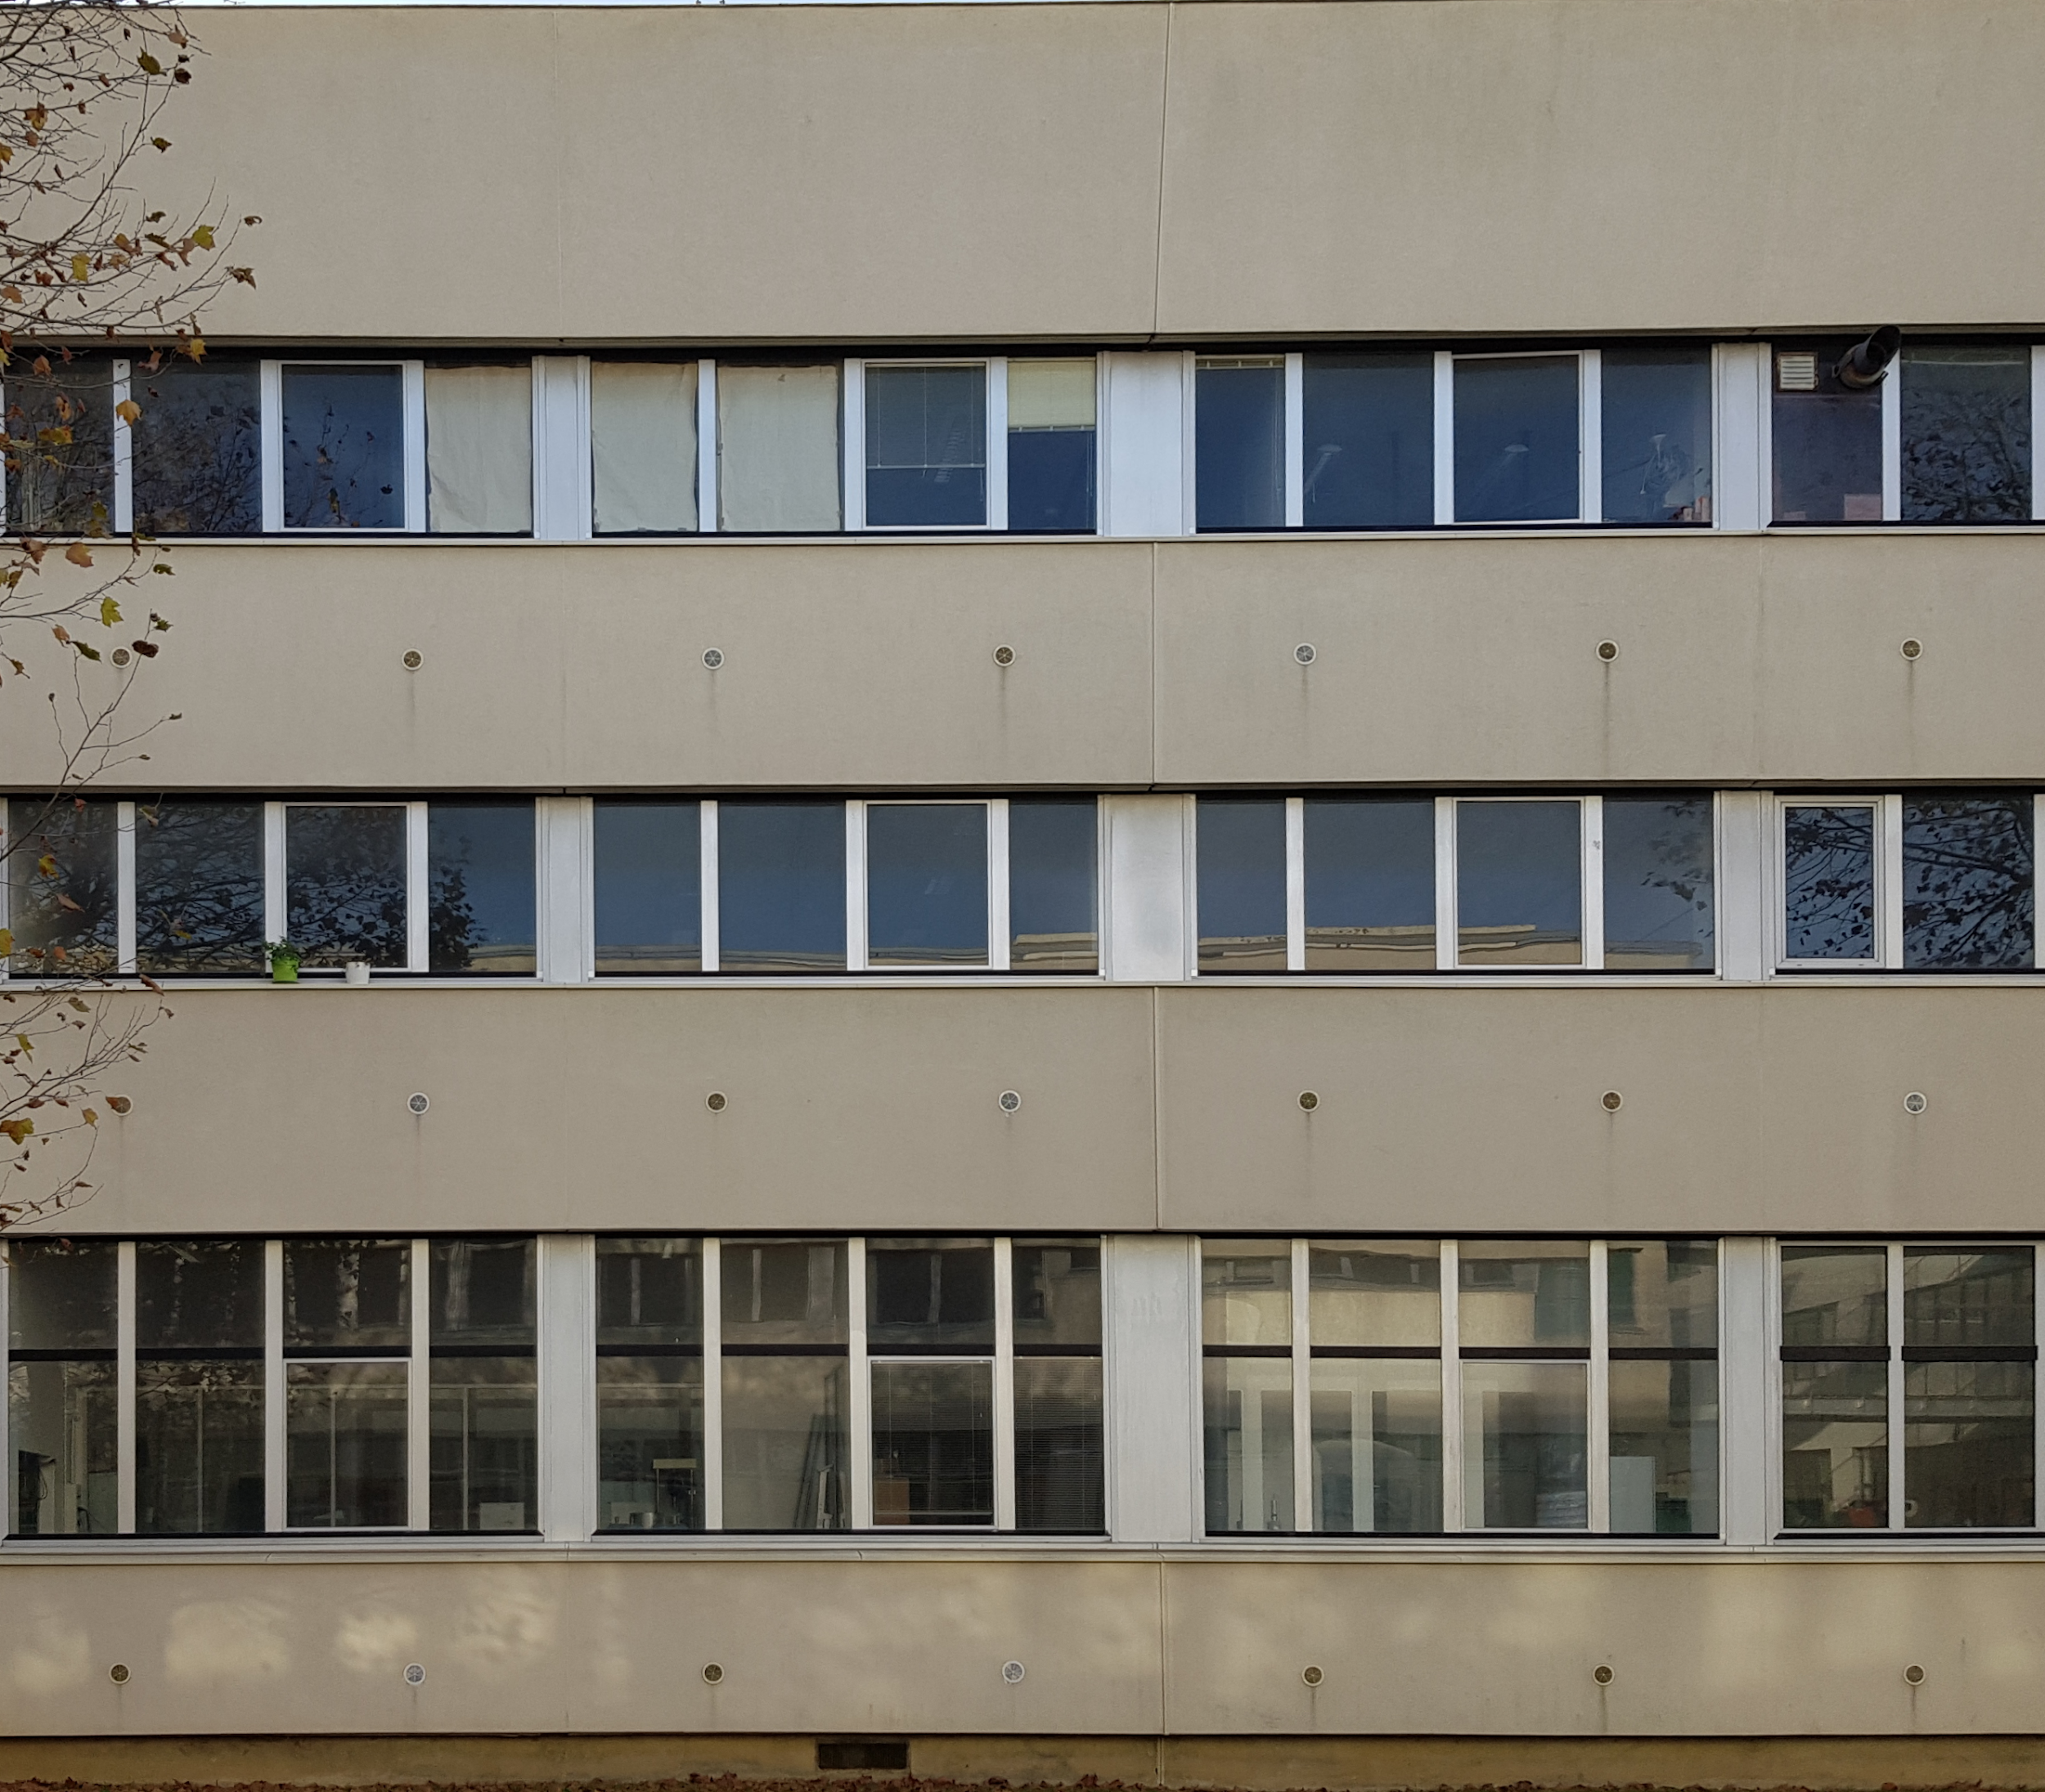
Examples

Slide 13
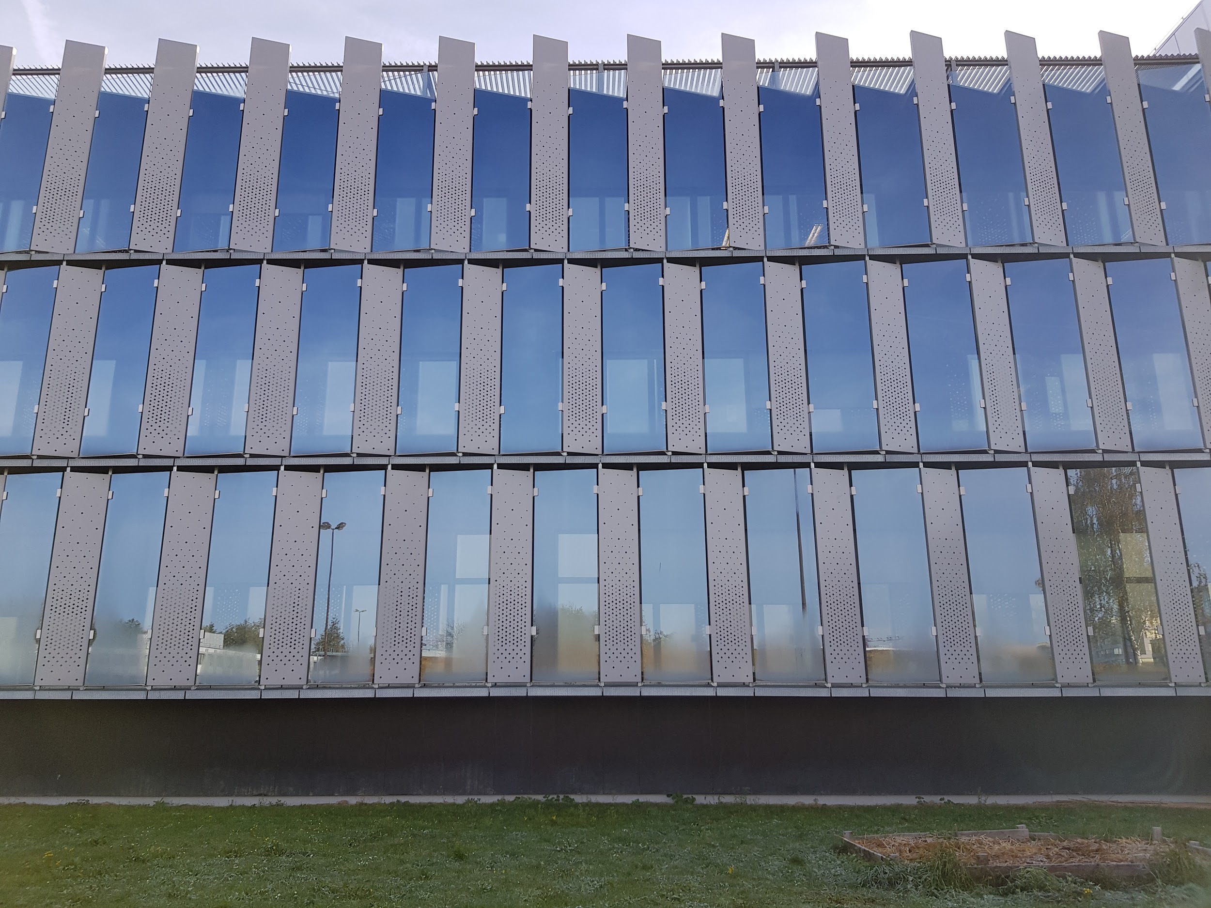
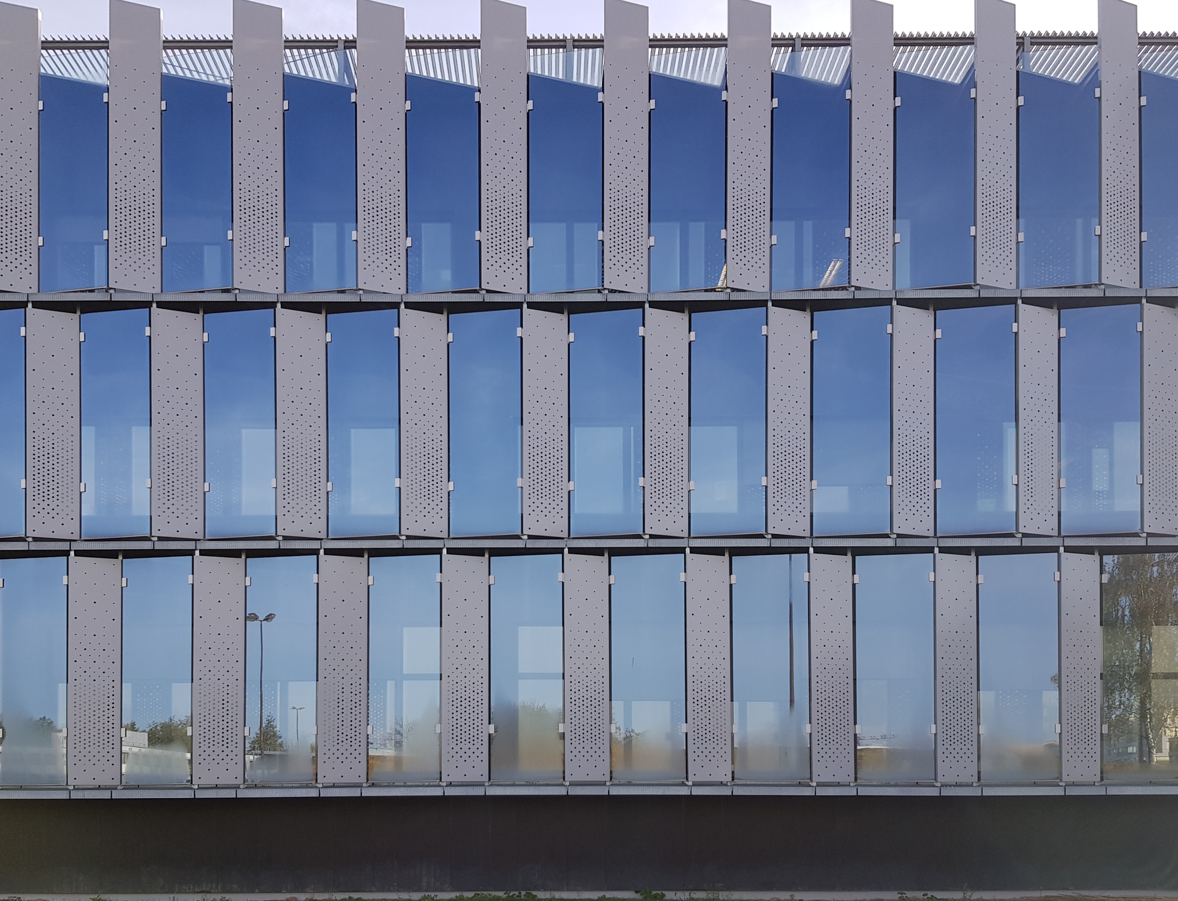
Examples

Slide 14
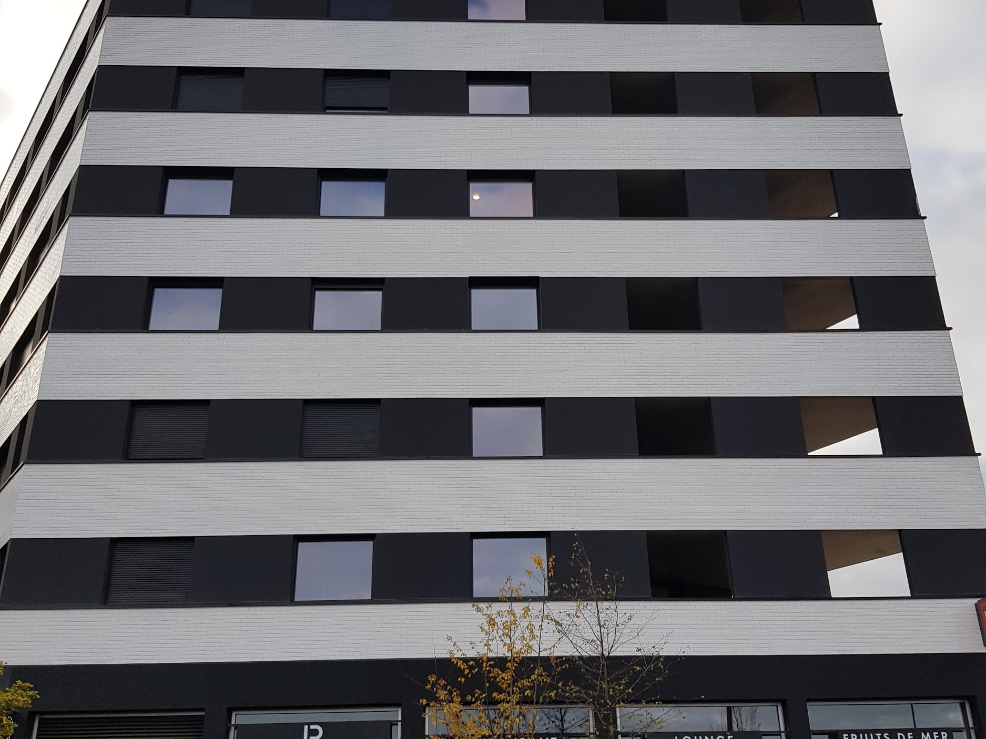
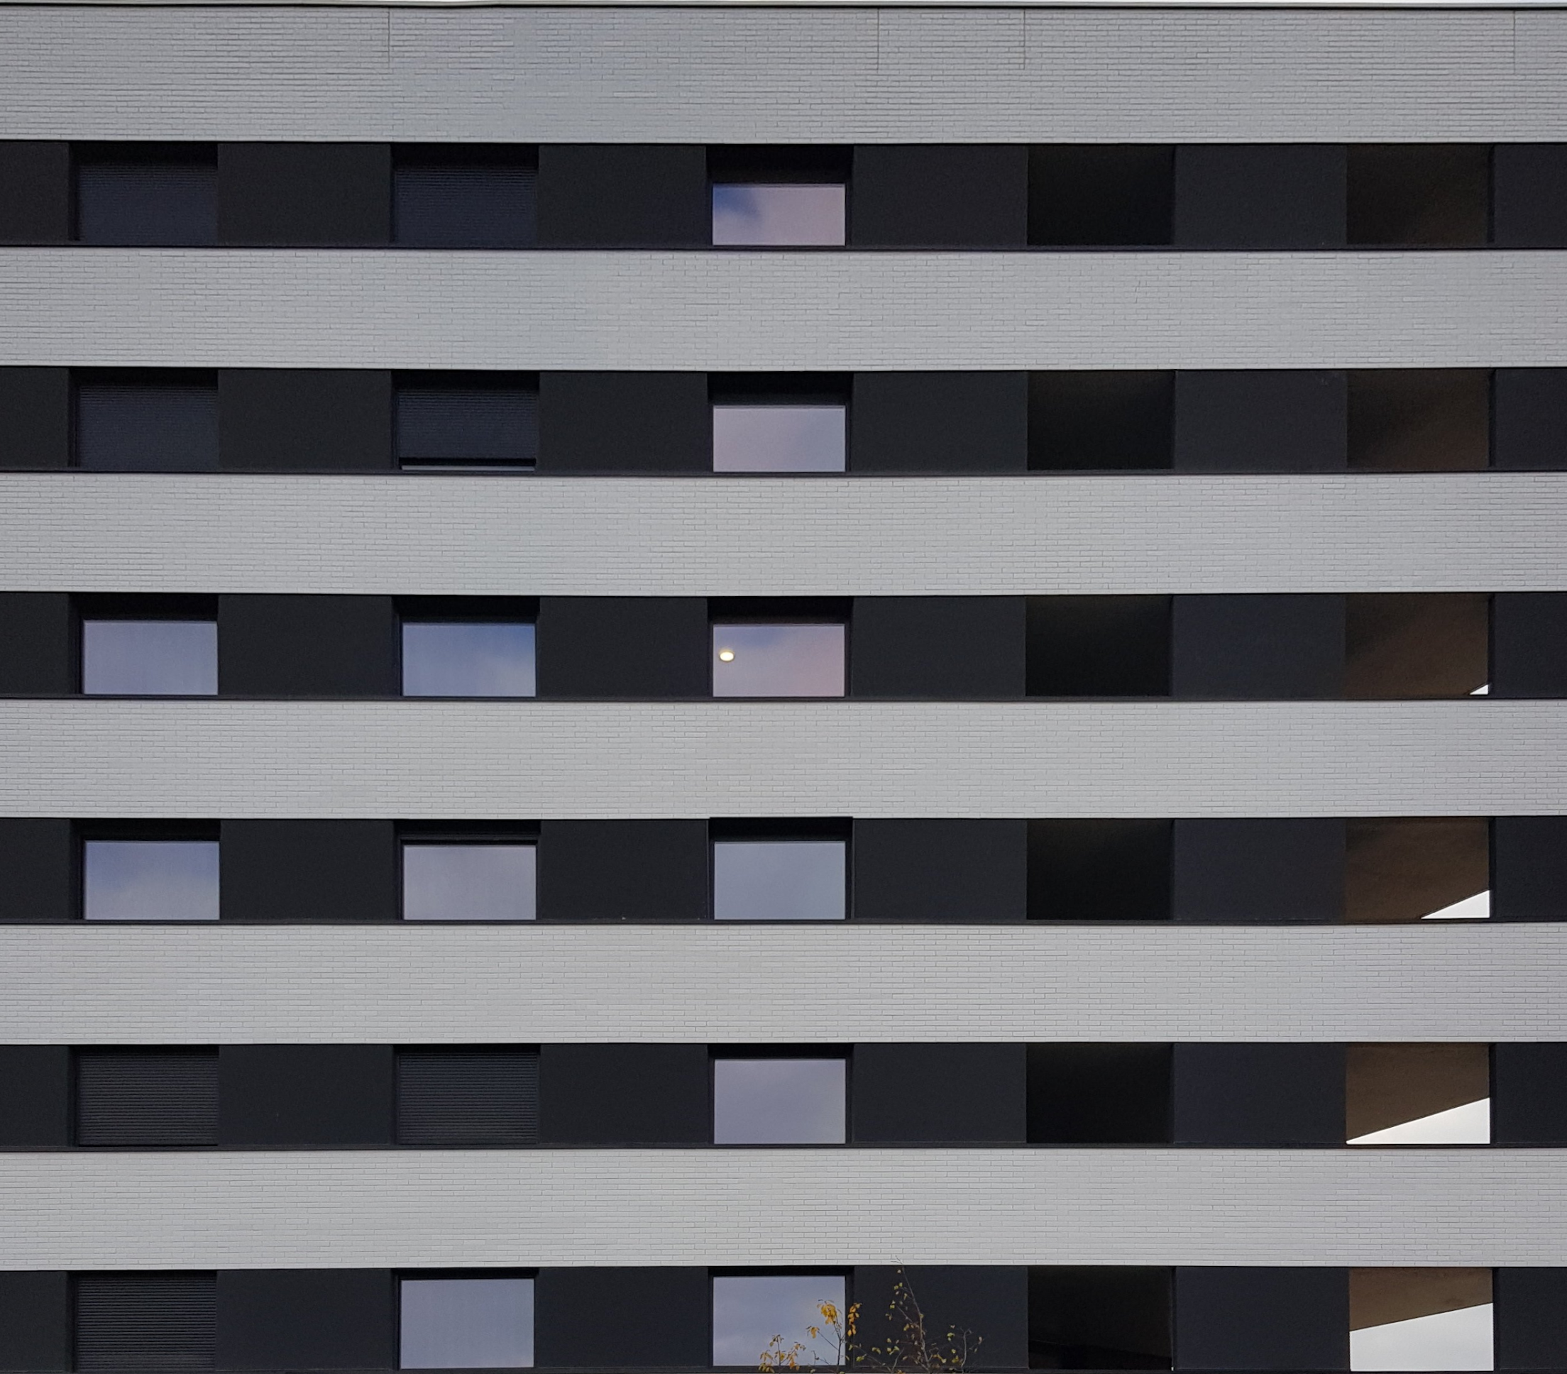
Examples

Slide 15
3
K-means approach

Slide 16
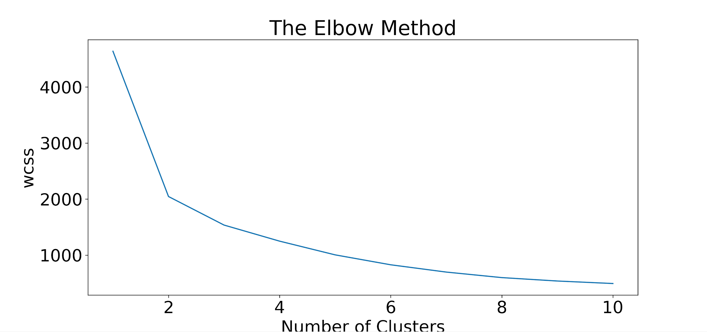
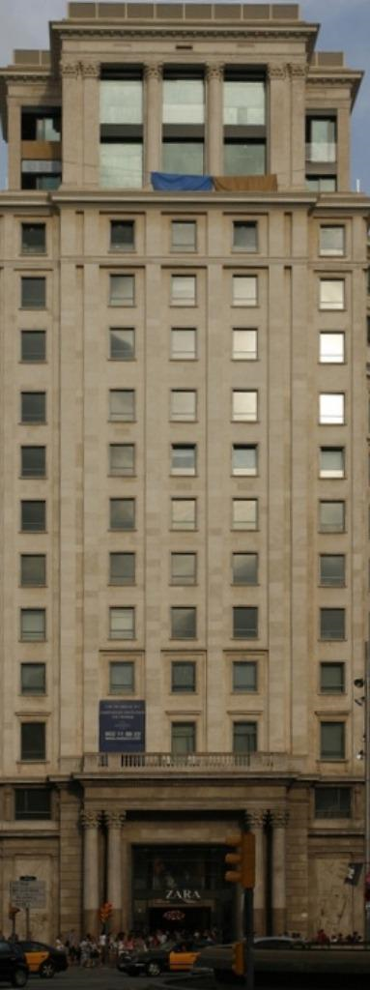
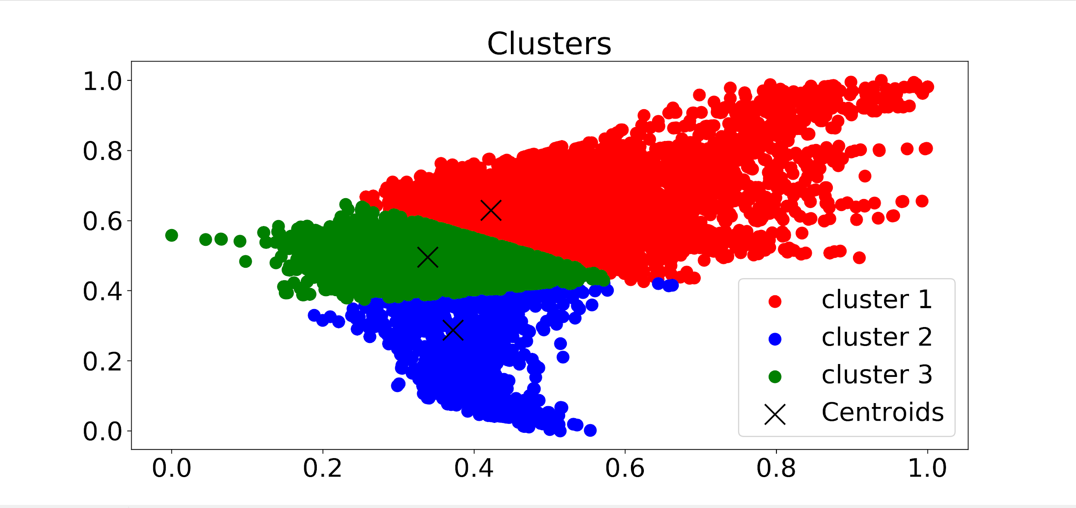
Color space reduction using K-means
CIE L*a*b space

Slide 17

Computing K-means

Slide 18
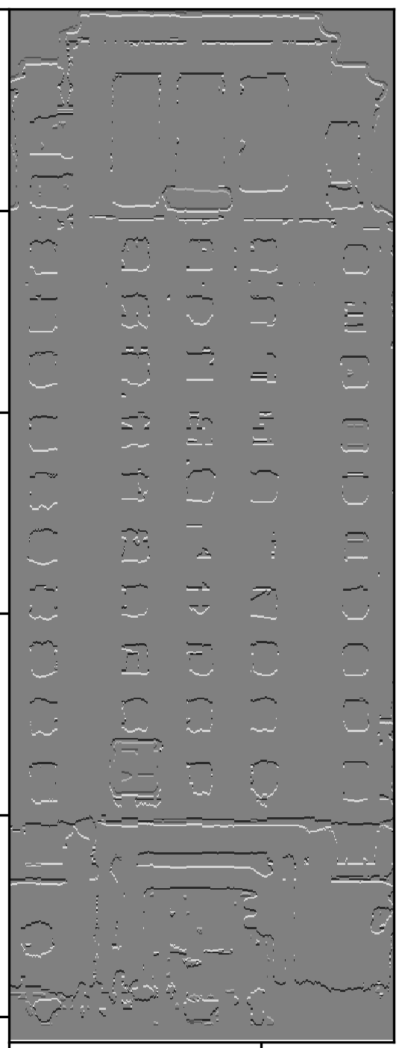
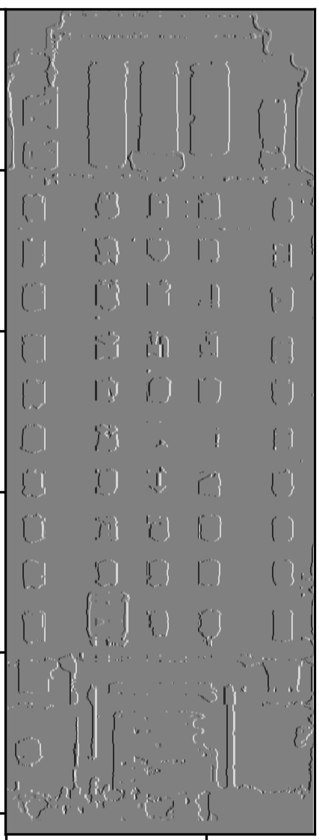
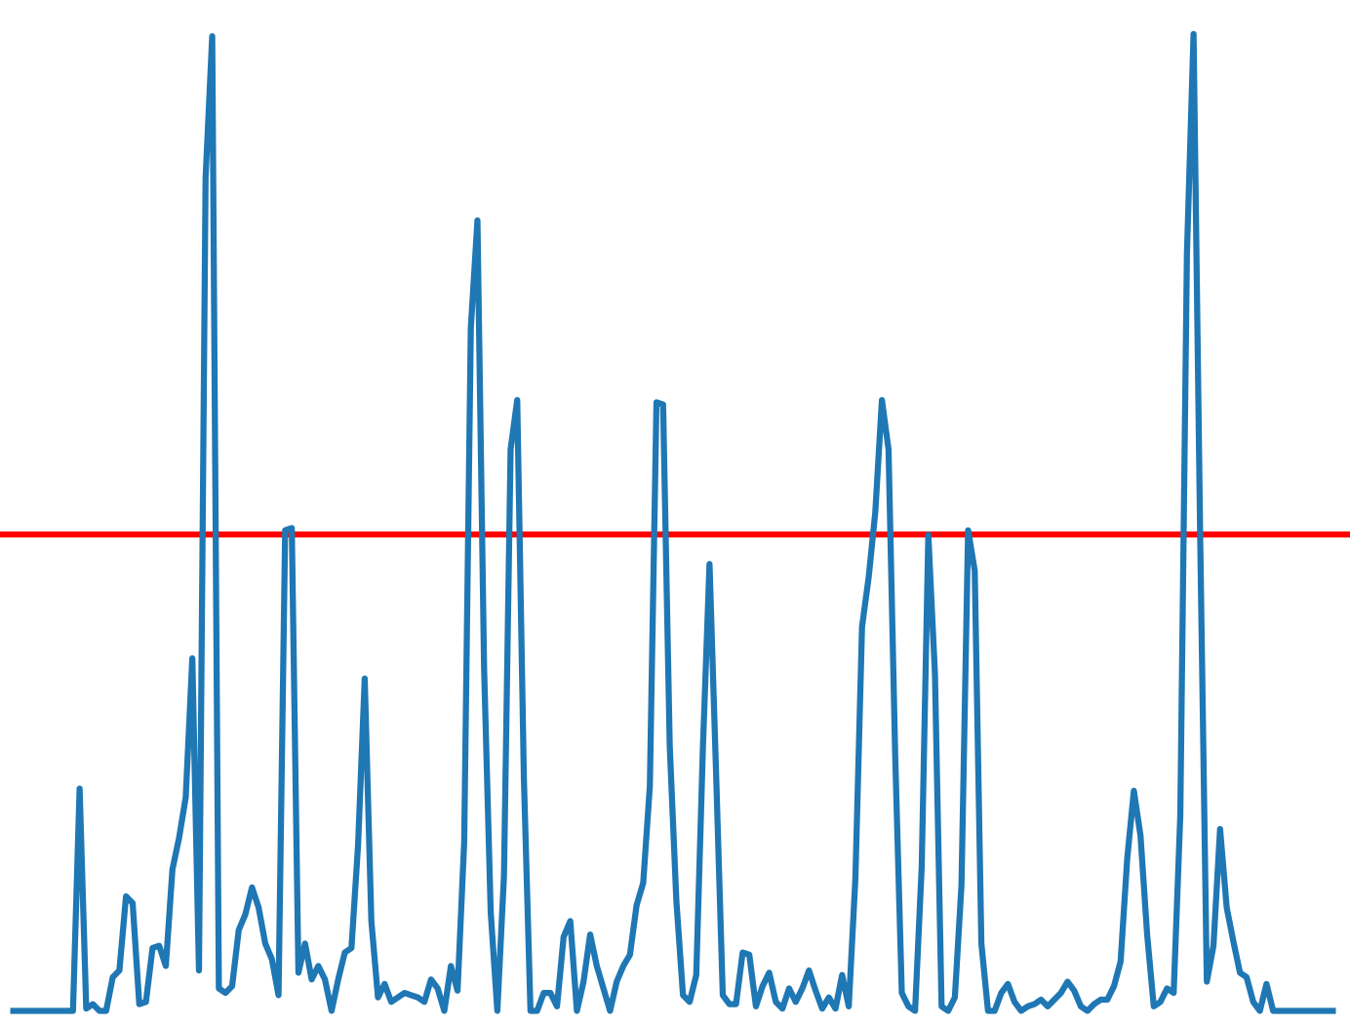
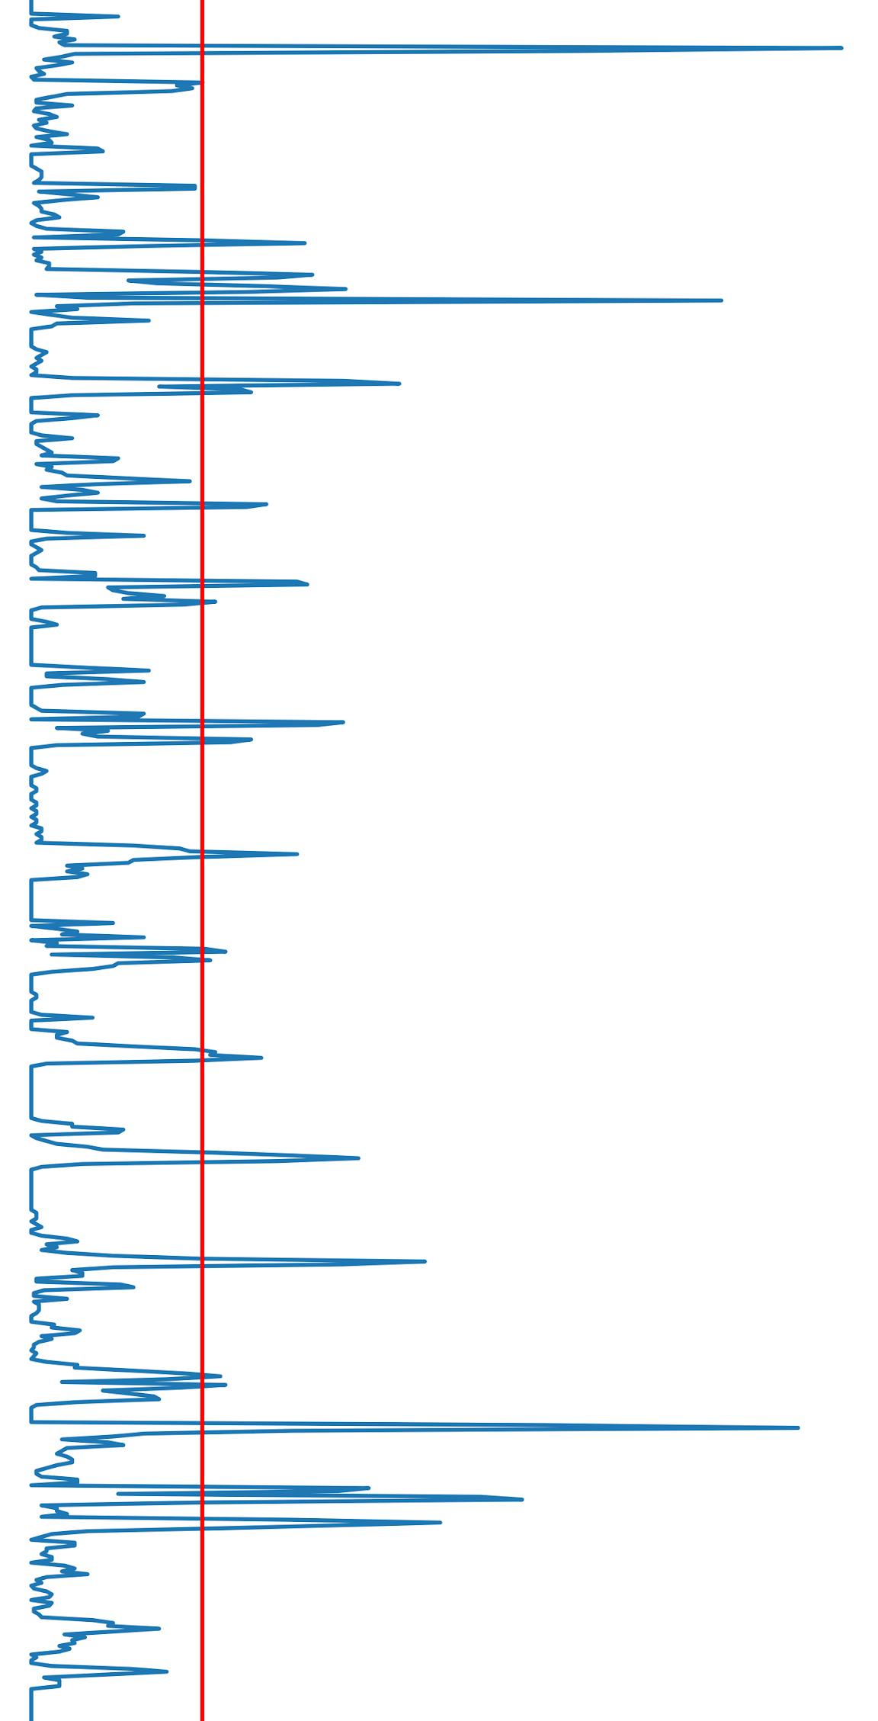
Identifying edges from a three-color image
Detect horizontal edges (parallel to x)
Detect vertical edges (parallel to y)

Slide 19
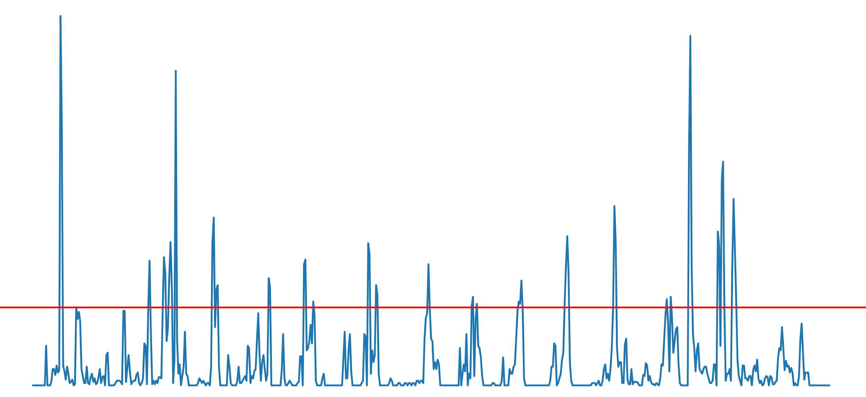
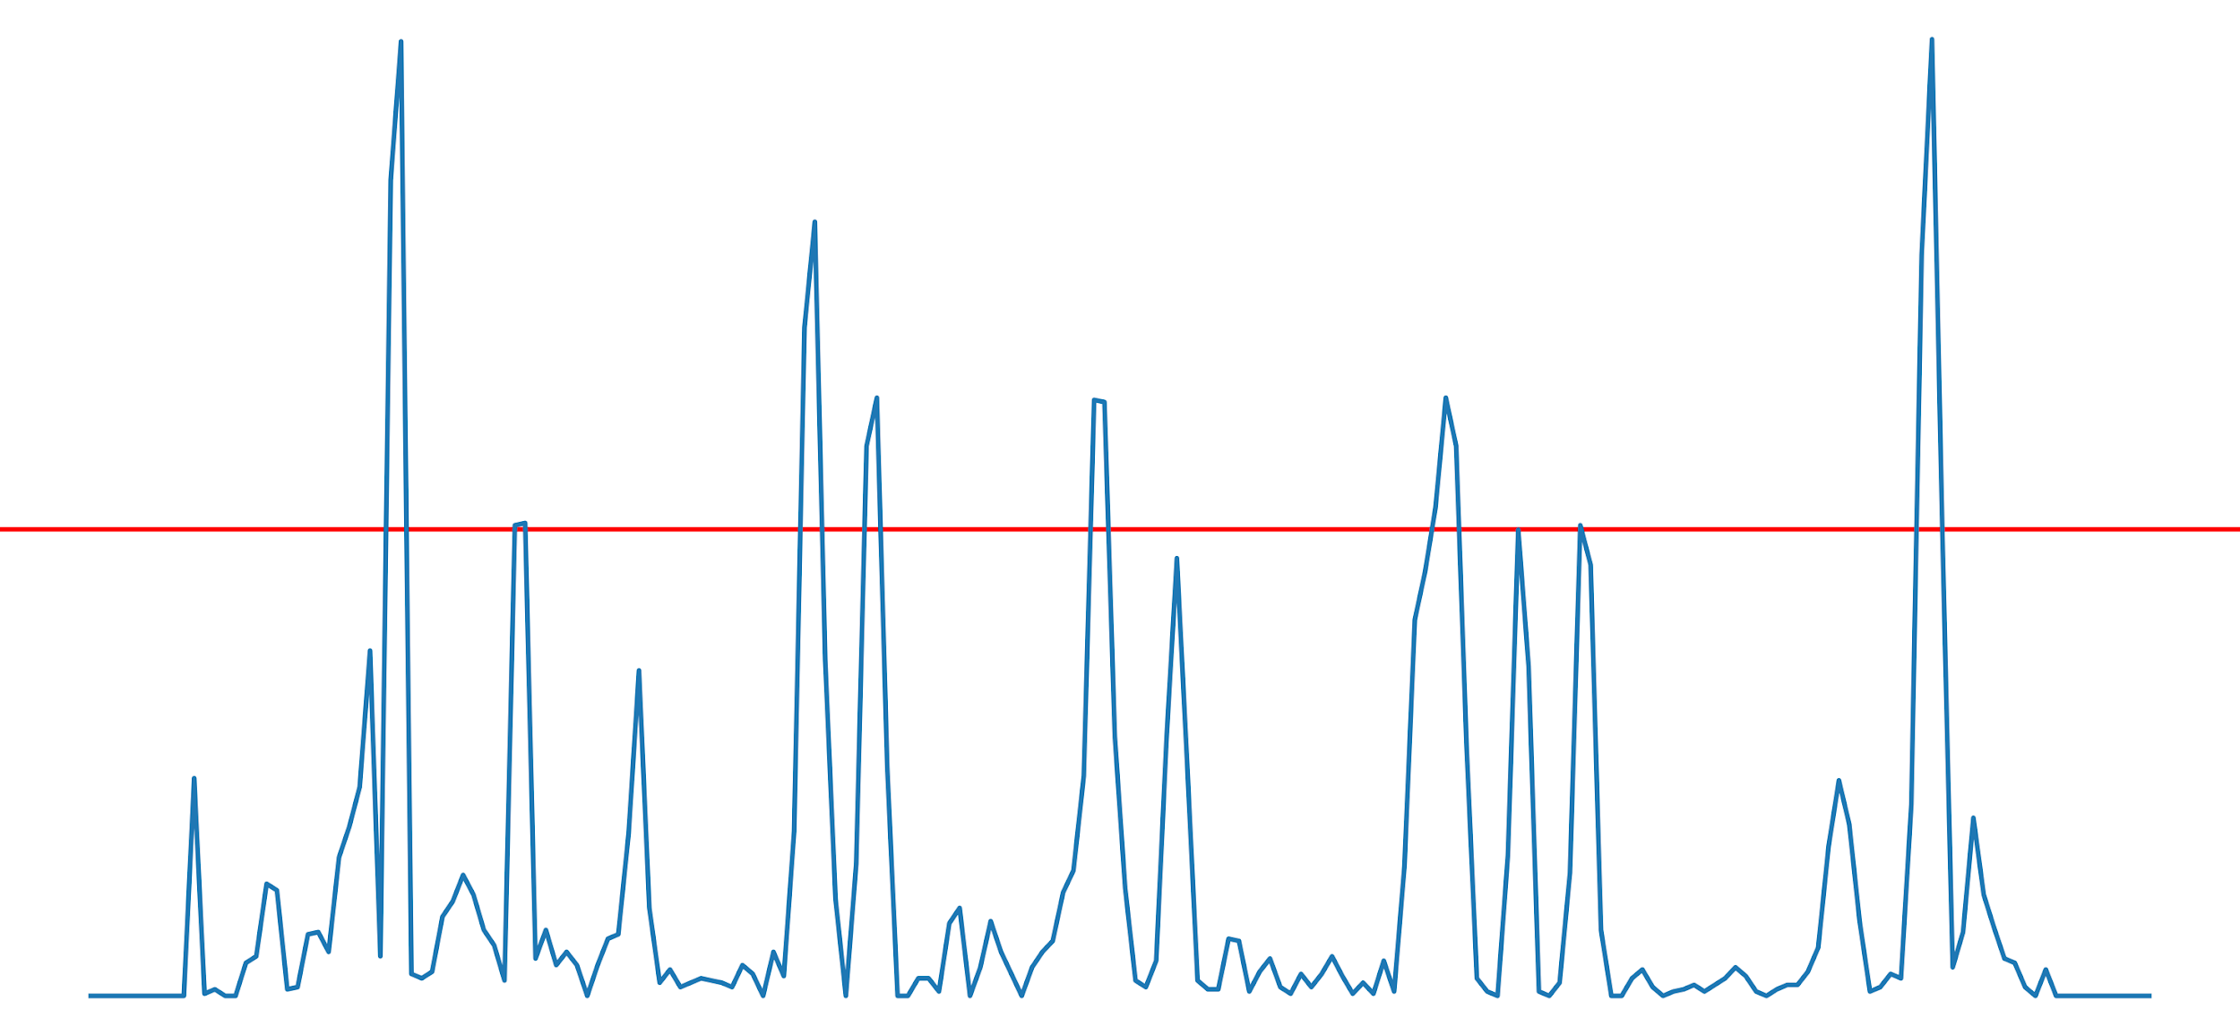
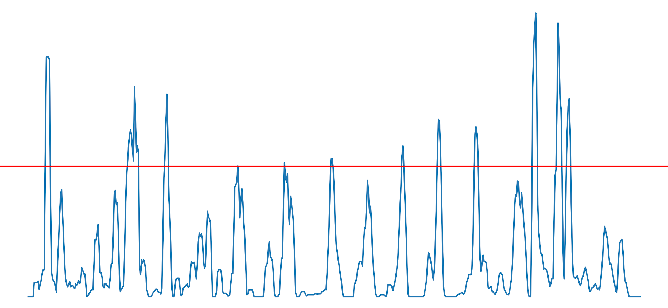
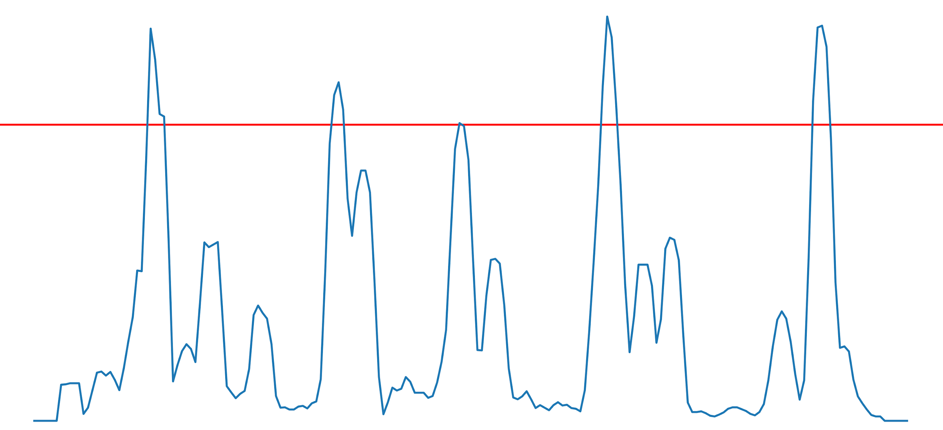
Counting
Before
Before
After
After
Moving average for floors
Moving average for windows

Slide 20
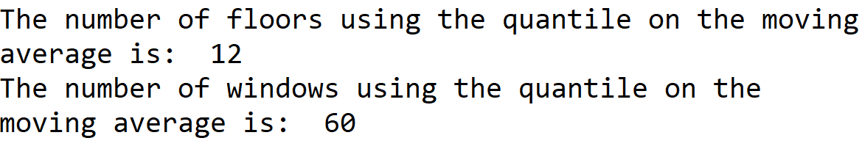
Counting

Slide 21
4
Edge Projection

Slide 22
Edge Detection
Image Pre-processing
Comparison of techniques
Morphological Operations
Edge Projection

Slide 23
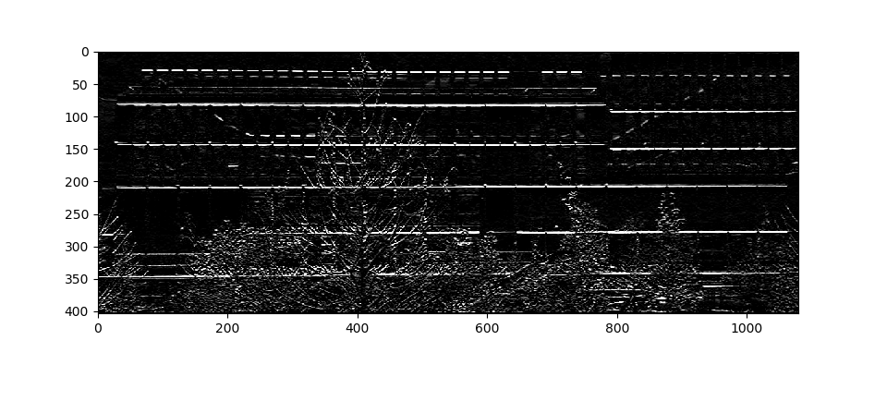
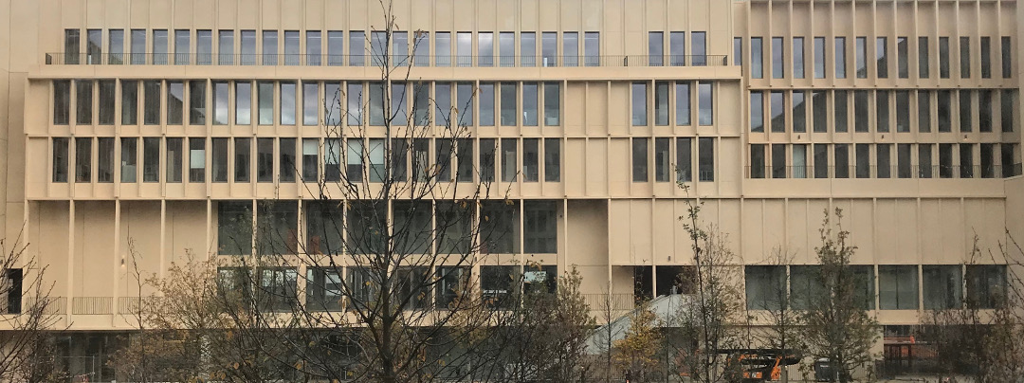
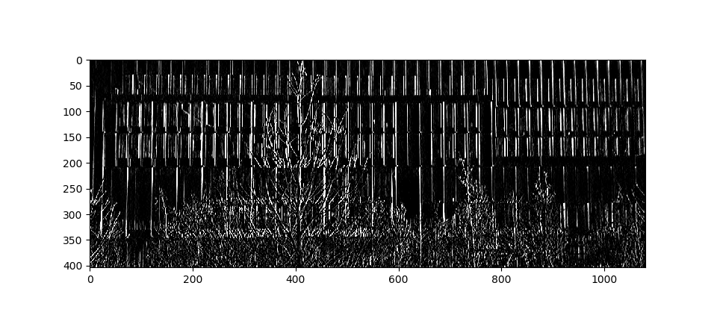
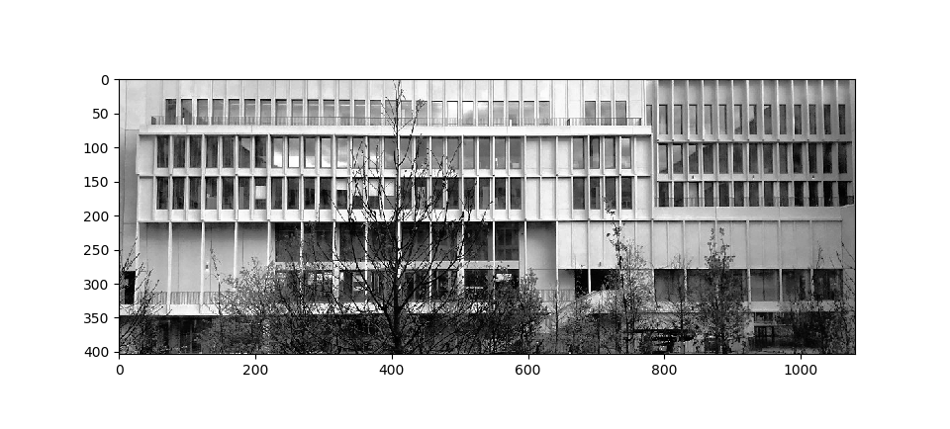
Computing horizontal and vertical gradients
Grayscale
Histogram equalization

Slide 24
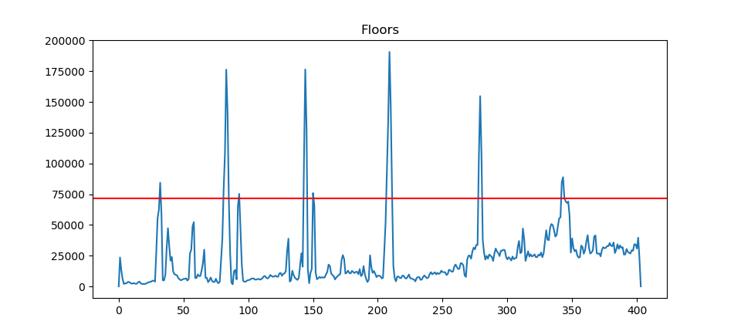
Axis projection (horizontal)

Slide 25
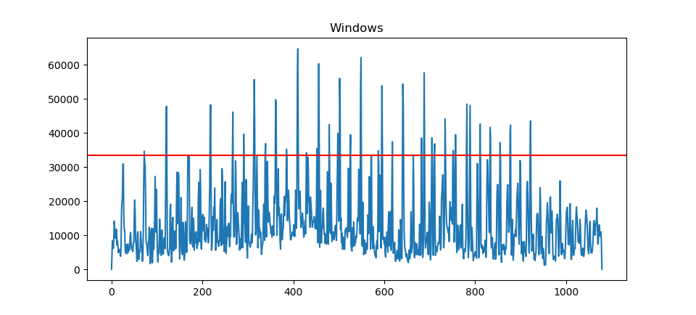
Axis projection (vertical)

Slide 26
Infering “probable” window position from peaks

Slide 27
For every box, do a horizontal matching search
Due to noise, we get a lot of “probable” windows. We need a metric to filter them.
First, we filter by the box size (only keep large boxes).
Then, we count the number of times “similar” shapes, on the picture, are seen on the same line of the image. We assume that a window will be repeated many times on the same line.

Slide 28
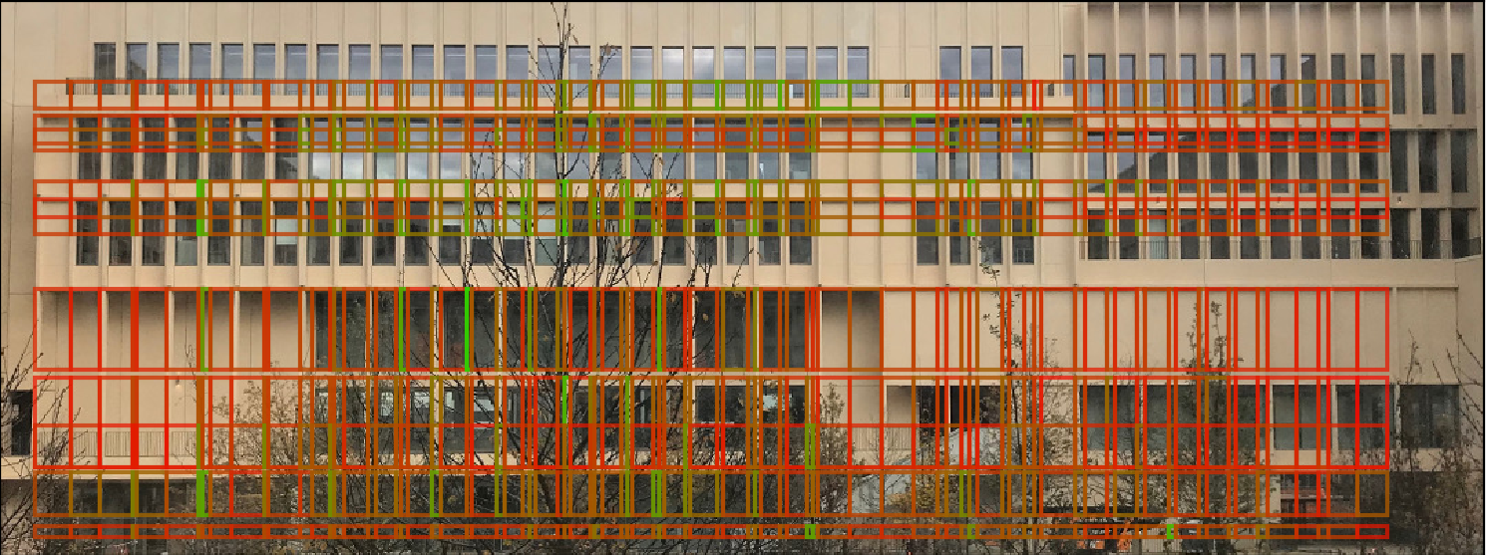
Window boxes plotting
Green = Good pattern matching score

Slide 29
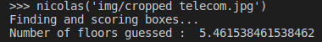
Floors number approximation
Approximate number of floors =
Building height / largest window height

Slide 30
5
Conclusion

Slide 31

Goal achieved !
We counted the number of floors of Telecom Paris’ building ! Mission’s achieved !...
Almost : our methods don’t generalize well.

Slide 32
Conclusion
A though problem (PhD thesis on the topic !)
Hard to generalize
Working with convolutional neural networks looks amazing
Very interesting experience

Slide 33
Thank you!
Any questions?
Floors & Window detection - ATHENS

